Slide 1
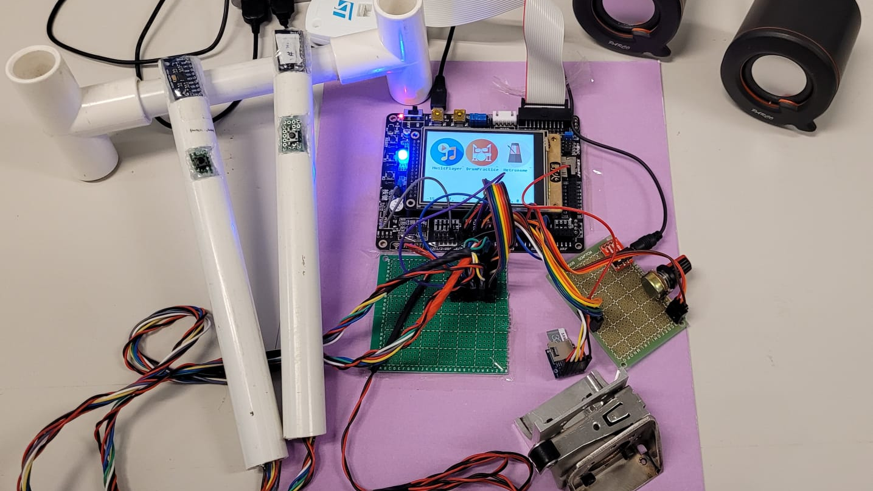
ELEC 3300
Proposal Presentation​ Group 44
Air Drum
Jeffrey Kwok, Ivan Ho, Terence Chan

Slide 2
Speaker/Earphone
IMU
GUI with Touch Screen
Init Buttons
Volume Control
Drum Sticks
SD card
Pedal

Slide 3
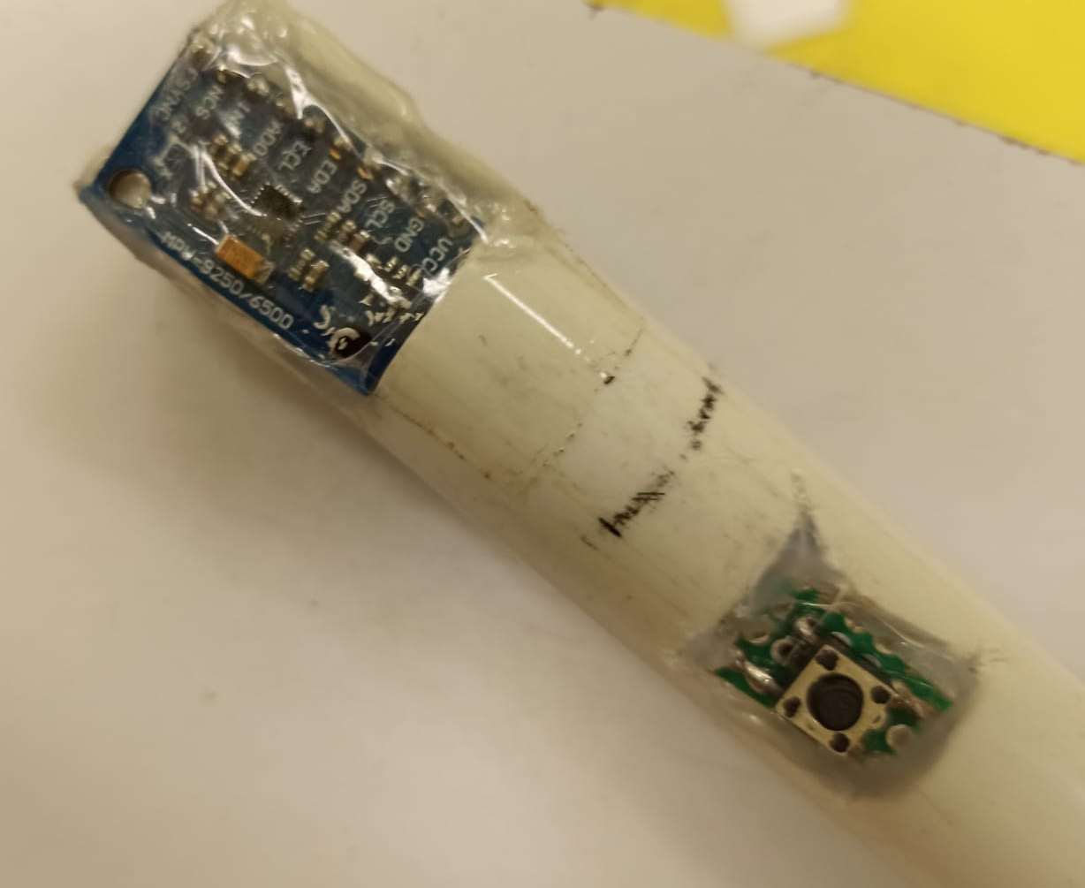
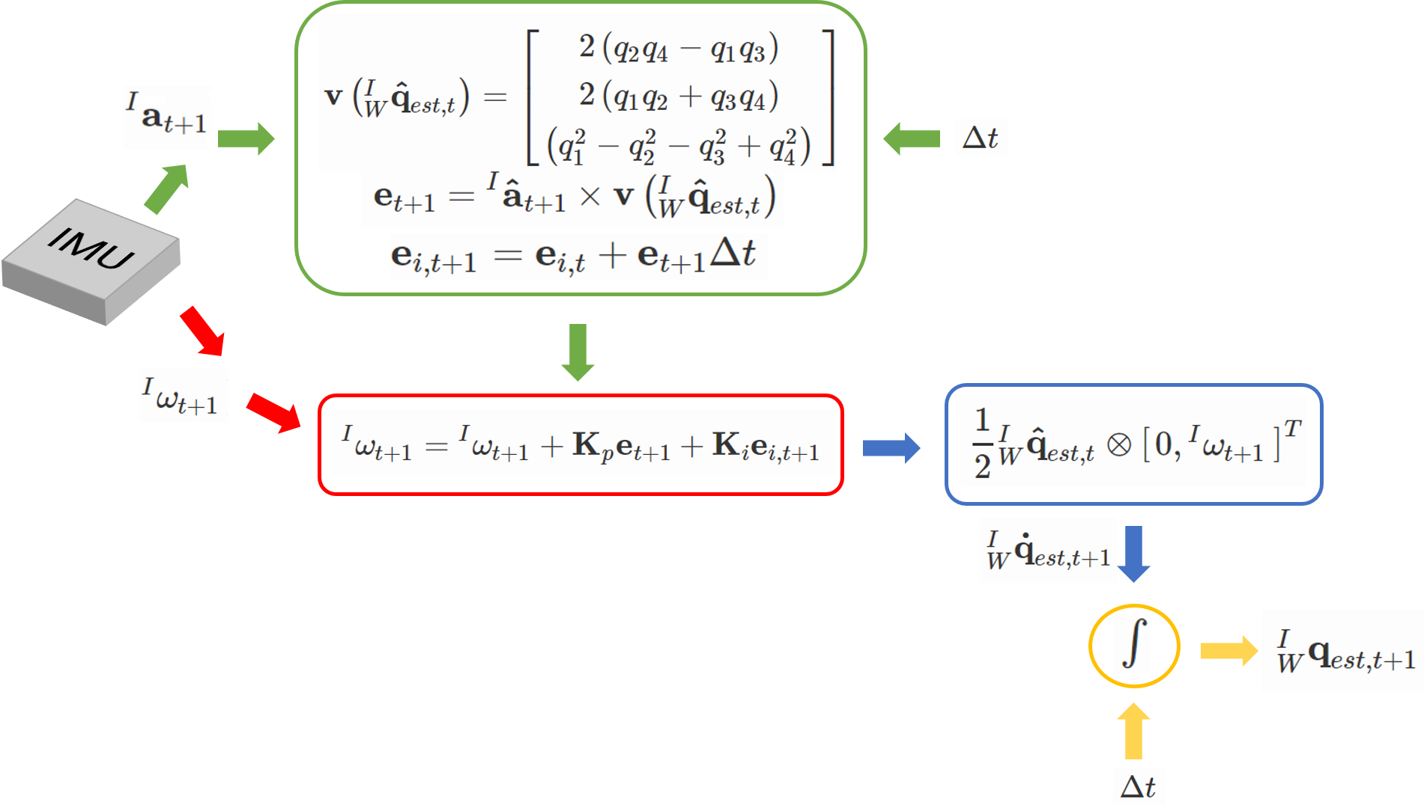
Drum Sticks Positioning via IMU
Using gryo + accel + mag to make accurate IMU orientation calculation (SPI)
Mahony/Madgwick Filter/Time Distance Formula
Limitations
Quick hand movement exceed IMU measursing range
Inconsistent MPU data (connection, hardware)
Large deviation even after filtering
Init button to rest the yaw position
Limited processing power of STM32F103VET6
MPU-9250
Nine-Axis Motion Track
(Gyro + Accelerometer + Compass)
Our Solution (Backup)
Use the Init button for changing drum sounds,
Use IMU only for accel detection

Slide 4
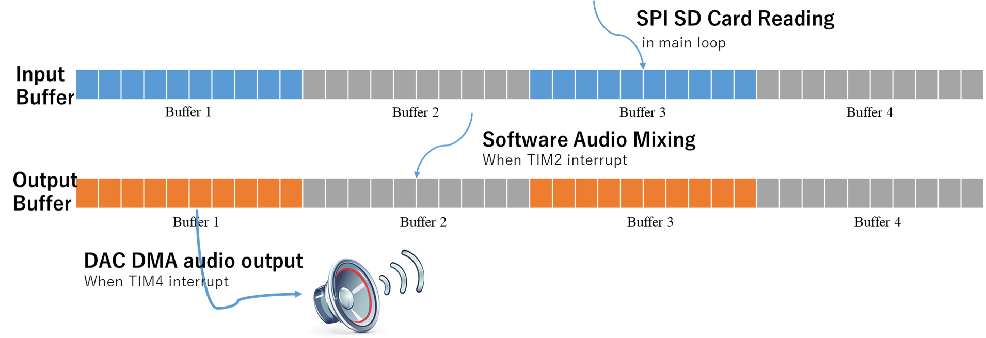
Audio Output Recording
Buffered Input (SD Card Reading) and Output (Audio Playback) using interrupt
f_open, f_read (from FATFS library)
.wav file
TIM4 triggers at 22050Hz
TIM2 triggers at 22050/500Hz
Audio Data Buffers
circular buffer
Notes:
The following is how we achieved audio output and recording.
Basically, we are using buffered input and output using interrupt.
I’ll first talk about playback.
To play music, we need to load music data from .wav files from FATFS.
However, the music data is just too large.
Therefore, we have to read part by part and store them in a buffer.
First, we will read 1000 bytes from the SD card (f_open and f_read commands) and store them in the input buffer. There is a necessity to do it in the main loop as f_read is time consuming. Reading more data at once reduces the overall waiting time.
Then, when TIM2 interrupts, the MCU will mix the data in the input buffer with drum sound audio data. It stores the mixed audio levels in the output buffer.
We have then set up a DMA for transferring the data in the output buffer to DAC for the speaker to play.
We are using a circular buffer so that we don’t have to start and stop the DMA.

Slide 5
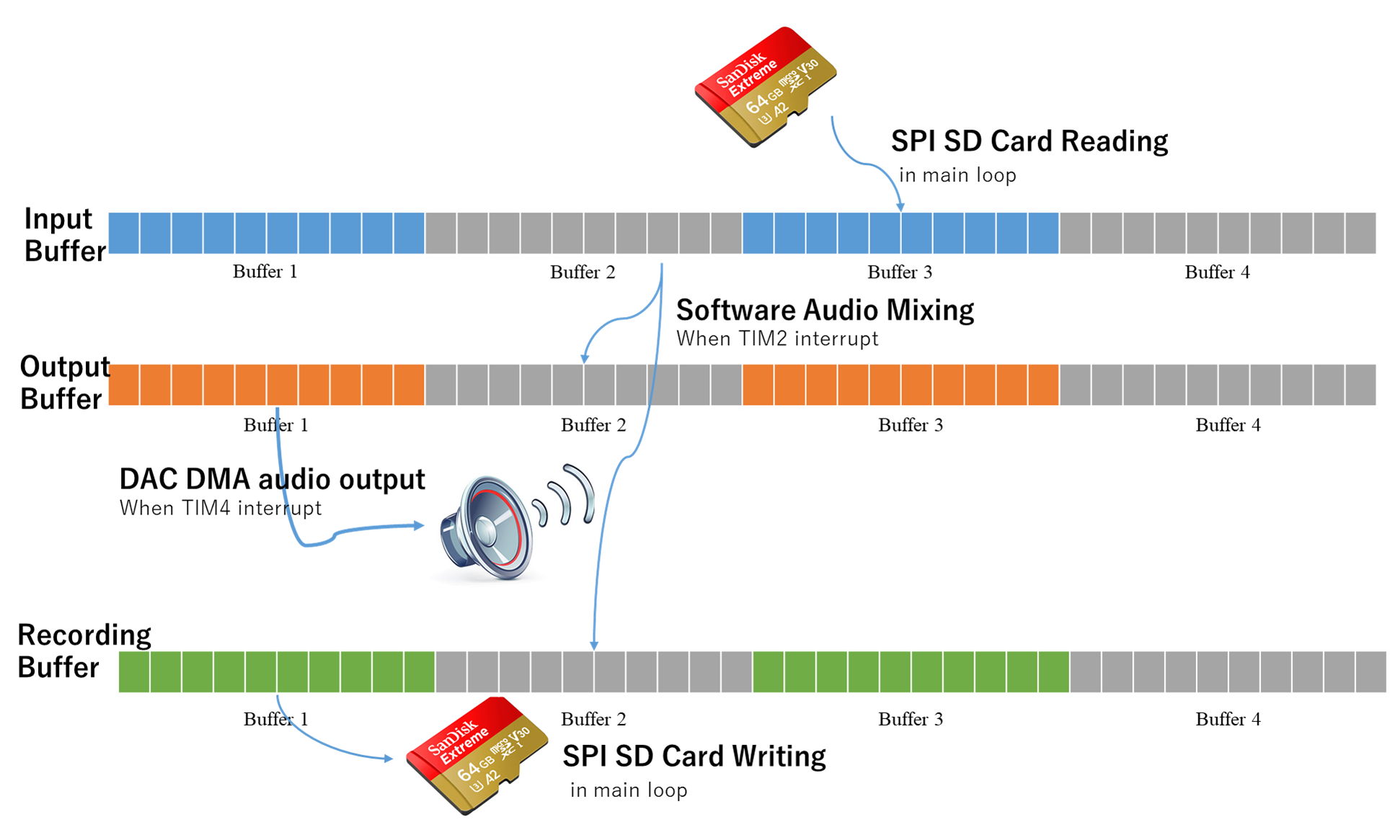
f_write
Notes:
Recording is done in a similar fashion. When the audio mixing is complete, the MCU will directly store this data in the recording buffer.
Then, in the main loop, the MCU will write this data into the SD card using the f_write command, and the audio is stored as a .wav file.

Slide 6
Limitations
if the MCU cannot read the SD card quick enough, the audio will lag
this method takes up a lot of memory space
Please note that programming these buffers are completely our own work. That also means it is likely that our architecture is not fully optimized and robust.
Notes:
Recording is done in a similar fashion. When the audio mixing is complete, the MCU will directly store this data in the recording buffer.
Then, in the main loop, the MCU will write this data into the SD card using the f_write command, and the audio is stored as a .wav file.

Slide 7
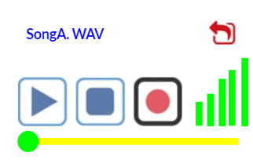
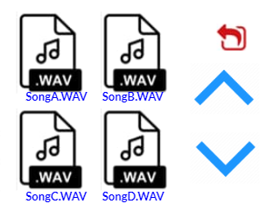


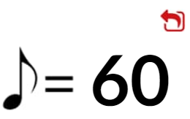
Graphical User Interface (GUI)
FileSelector
Read File Data (SD)
Multiple Pages
MusicPlayer
Play/ Pause / Stop Button
Recording
Timeline Draging
RealTime Volume Display
StartPage
IMU Configuration
SD Card Configuration
MainMenu
MusicPlayer
Metronome
Metronome
Music Rythum
BPM Switching

Slide 8
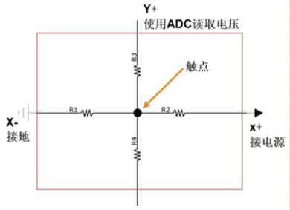
Graphical User Interface (GUI)
Technology used: FSMC + ADC
Design Process:
- User-friendly Interface for accessing different functions
- Boundary Coordination (ADC)
- Interface Switching (LIFO Stack Sequence)
Limitation:
- Processing Power→ Fundamental Functions → Update Frequency
Our Solution
- Update the information with slower frequency (Get tick)

Slide 9
Thank you!

